Slide 1
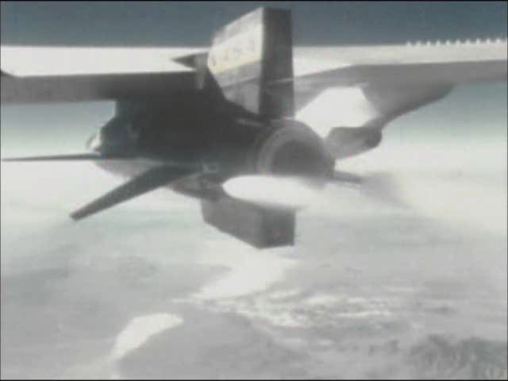

Slide 2
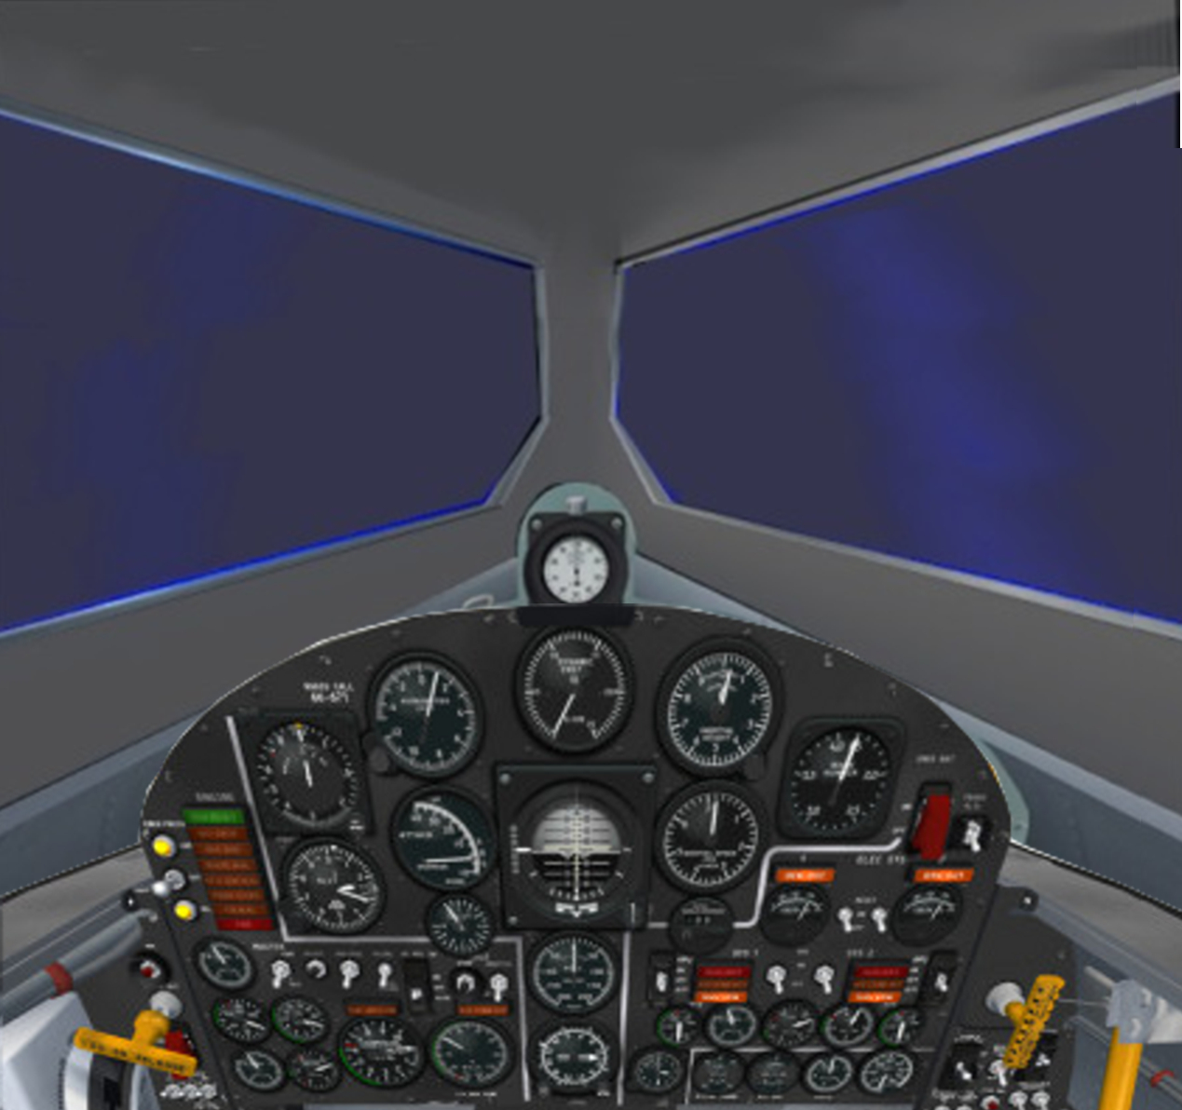
At Drop…
0 min 0 sec
600 mph
45,000 feet
1 second:
Rocket engine
lights.
3.2 seconds:
Full thrust
2G’s acceleration

Slide 3
~ 0 min 15 sec
1,000 mph
44,000 feet
Starting pullup
to climb attitude
Acceleration
increasing
as fuel burns

Slide 4
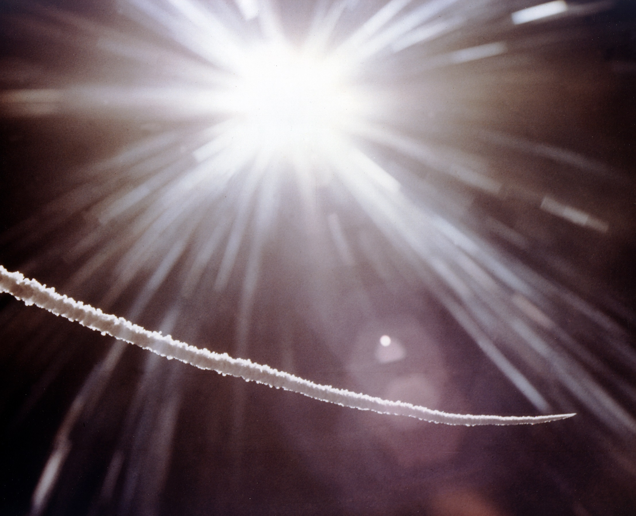

Slide 5
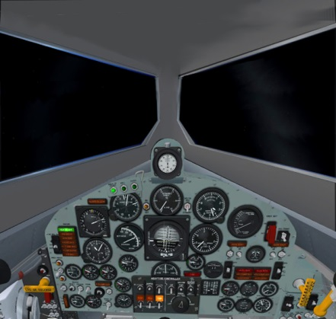
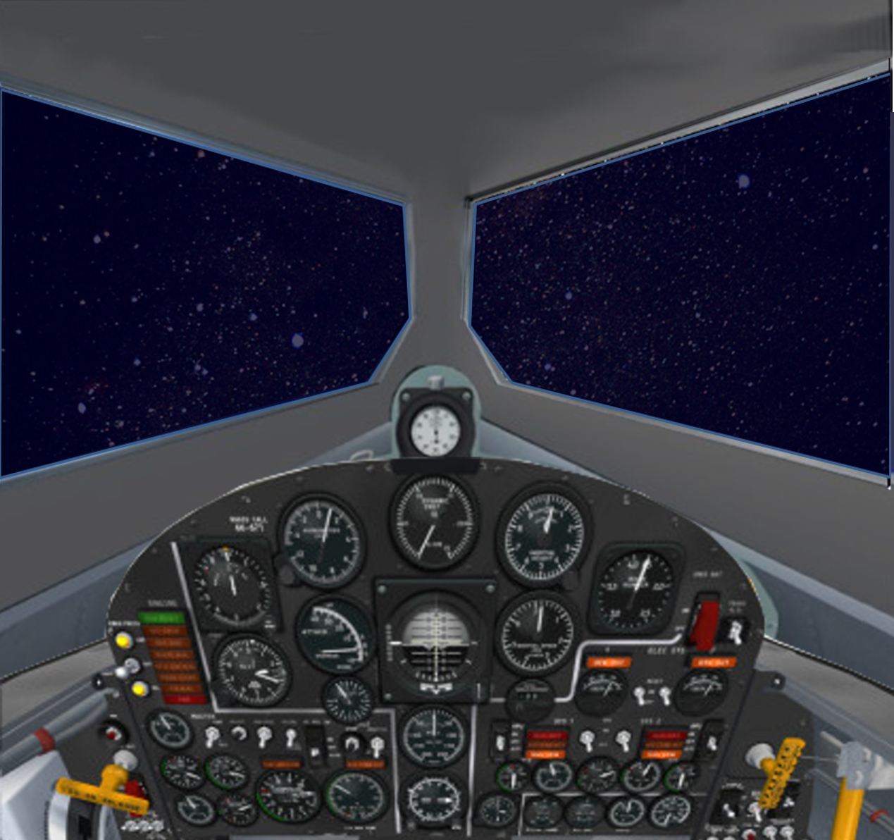
~ 0 min 30 sec
1,365 mph
55,000 feet
Sky going to
black,
Acceleration
increasing,
will reach 4G
before shutdown

Slide 6
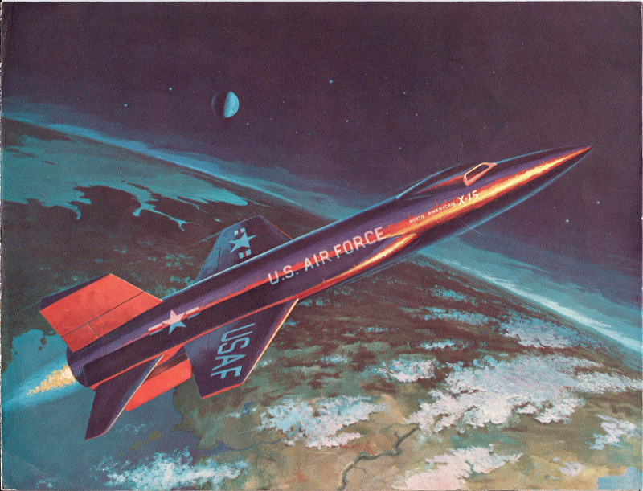

Slide 7
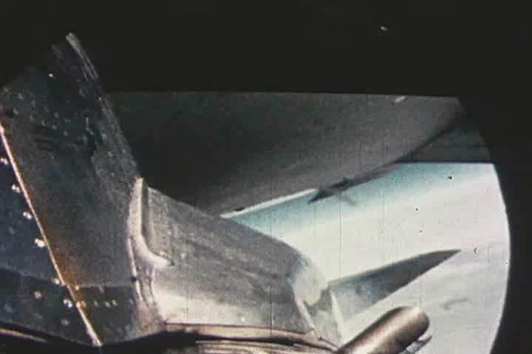

Slide 8
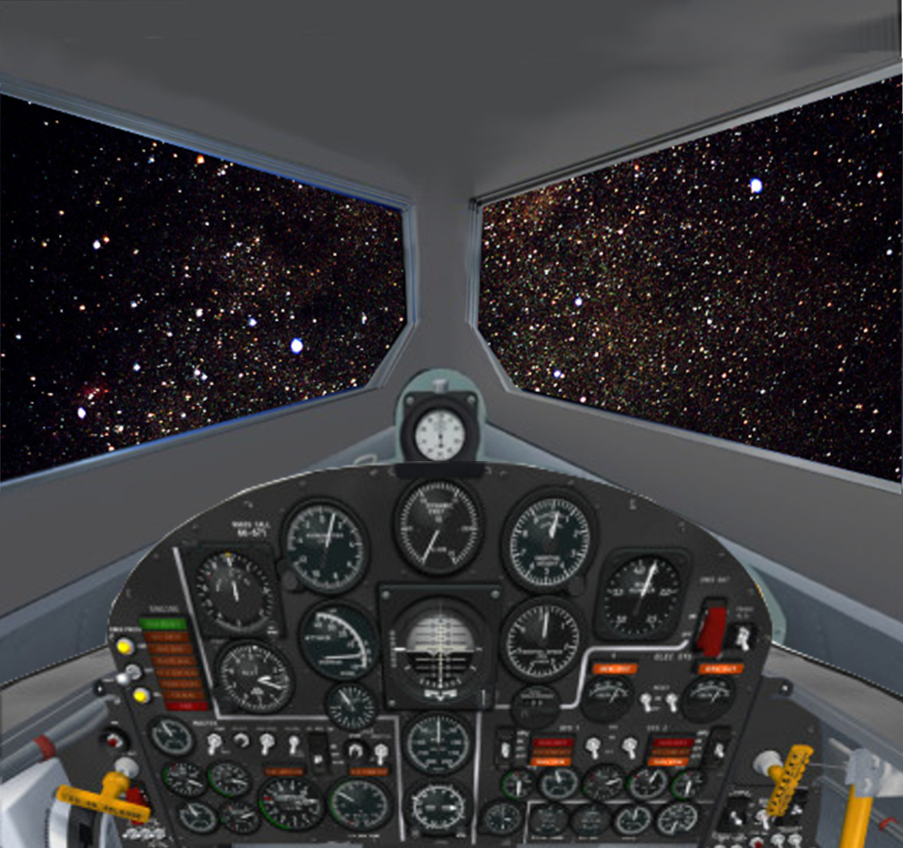
SHUTDOWN
rocket engine burnout
1 min 23.0 sec
3,545 mph
156,000 feet
Acceleration
drops abruptly
from 4G to 0G

Slide 9
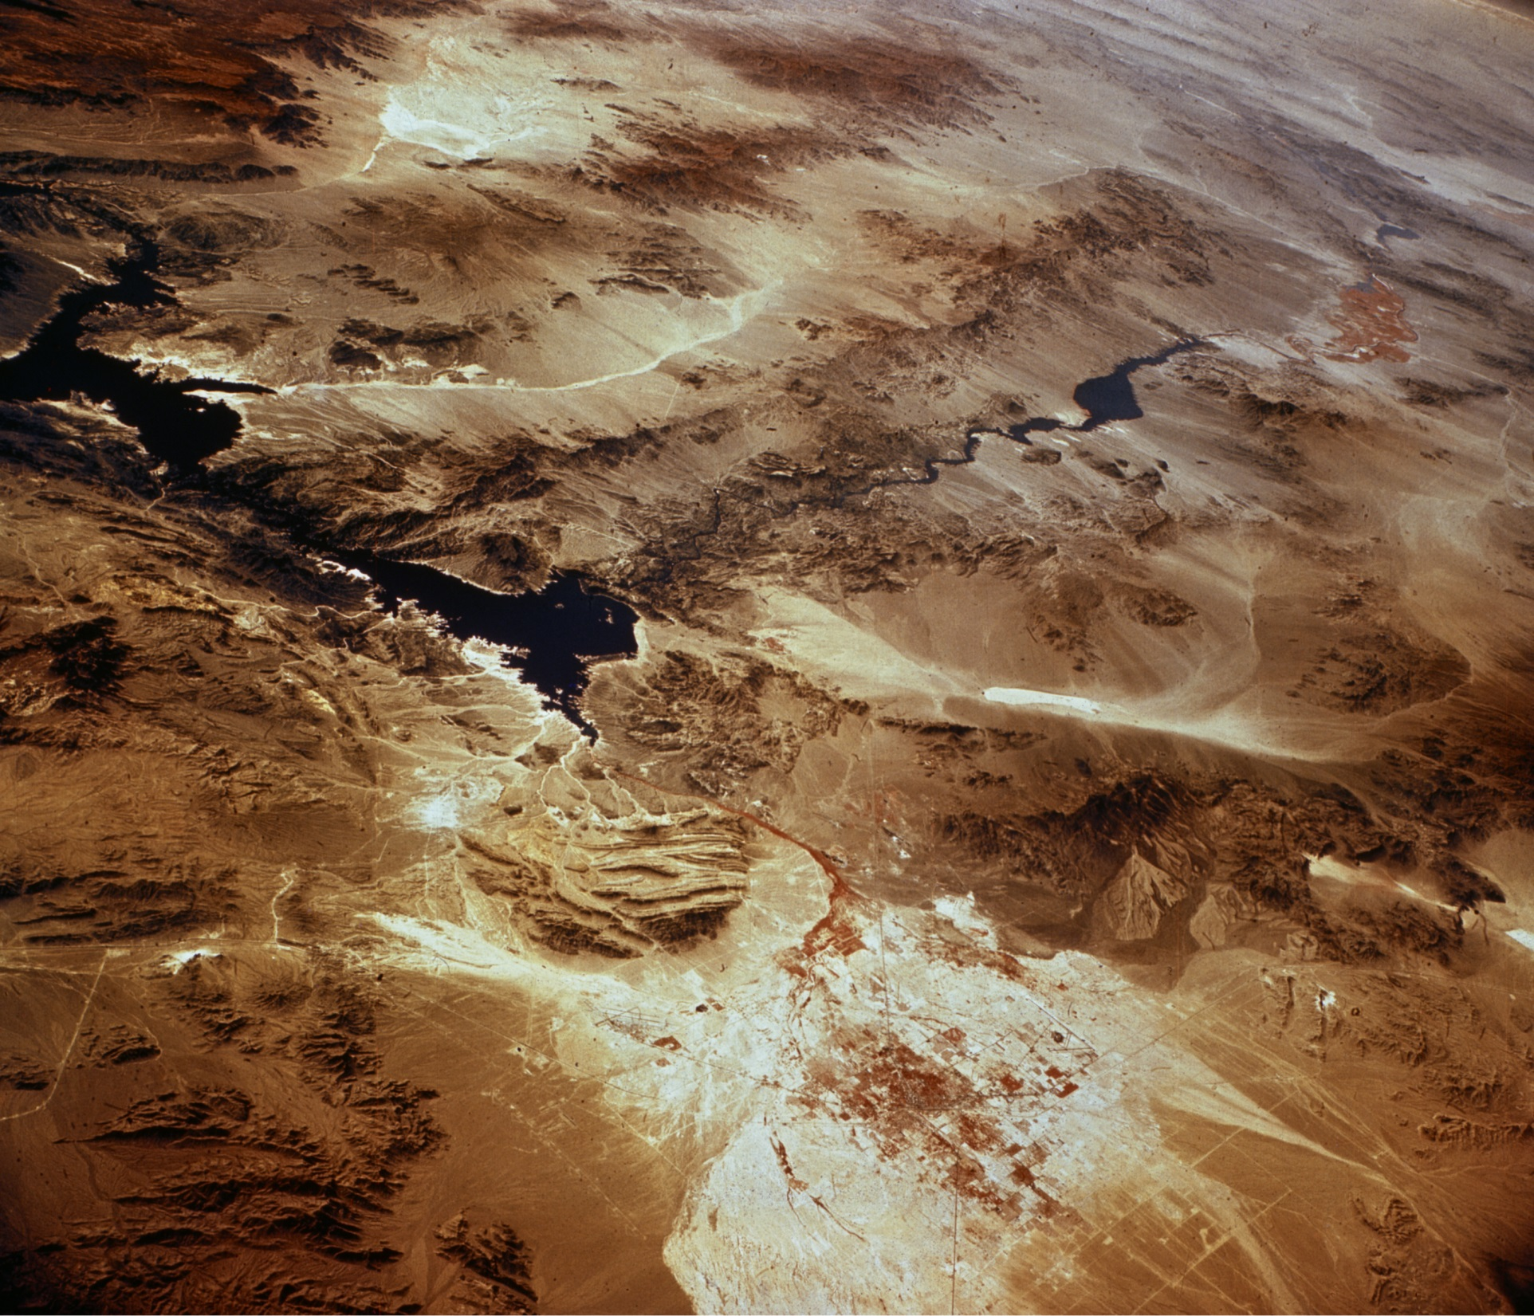
half way
to apogee

Slide 10
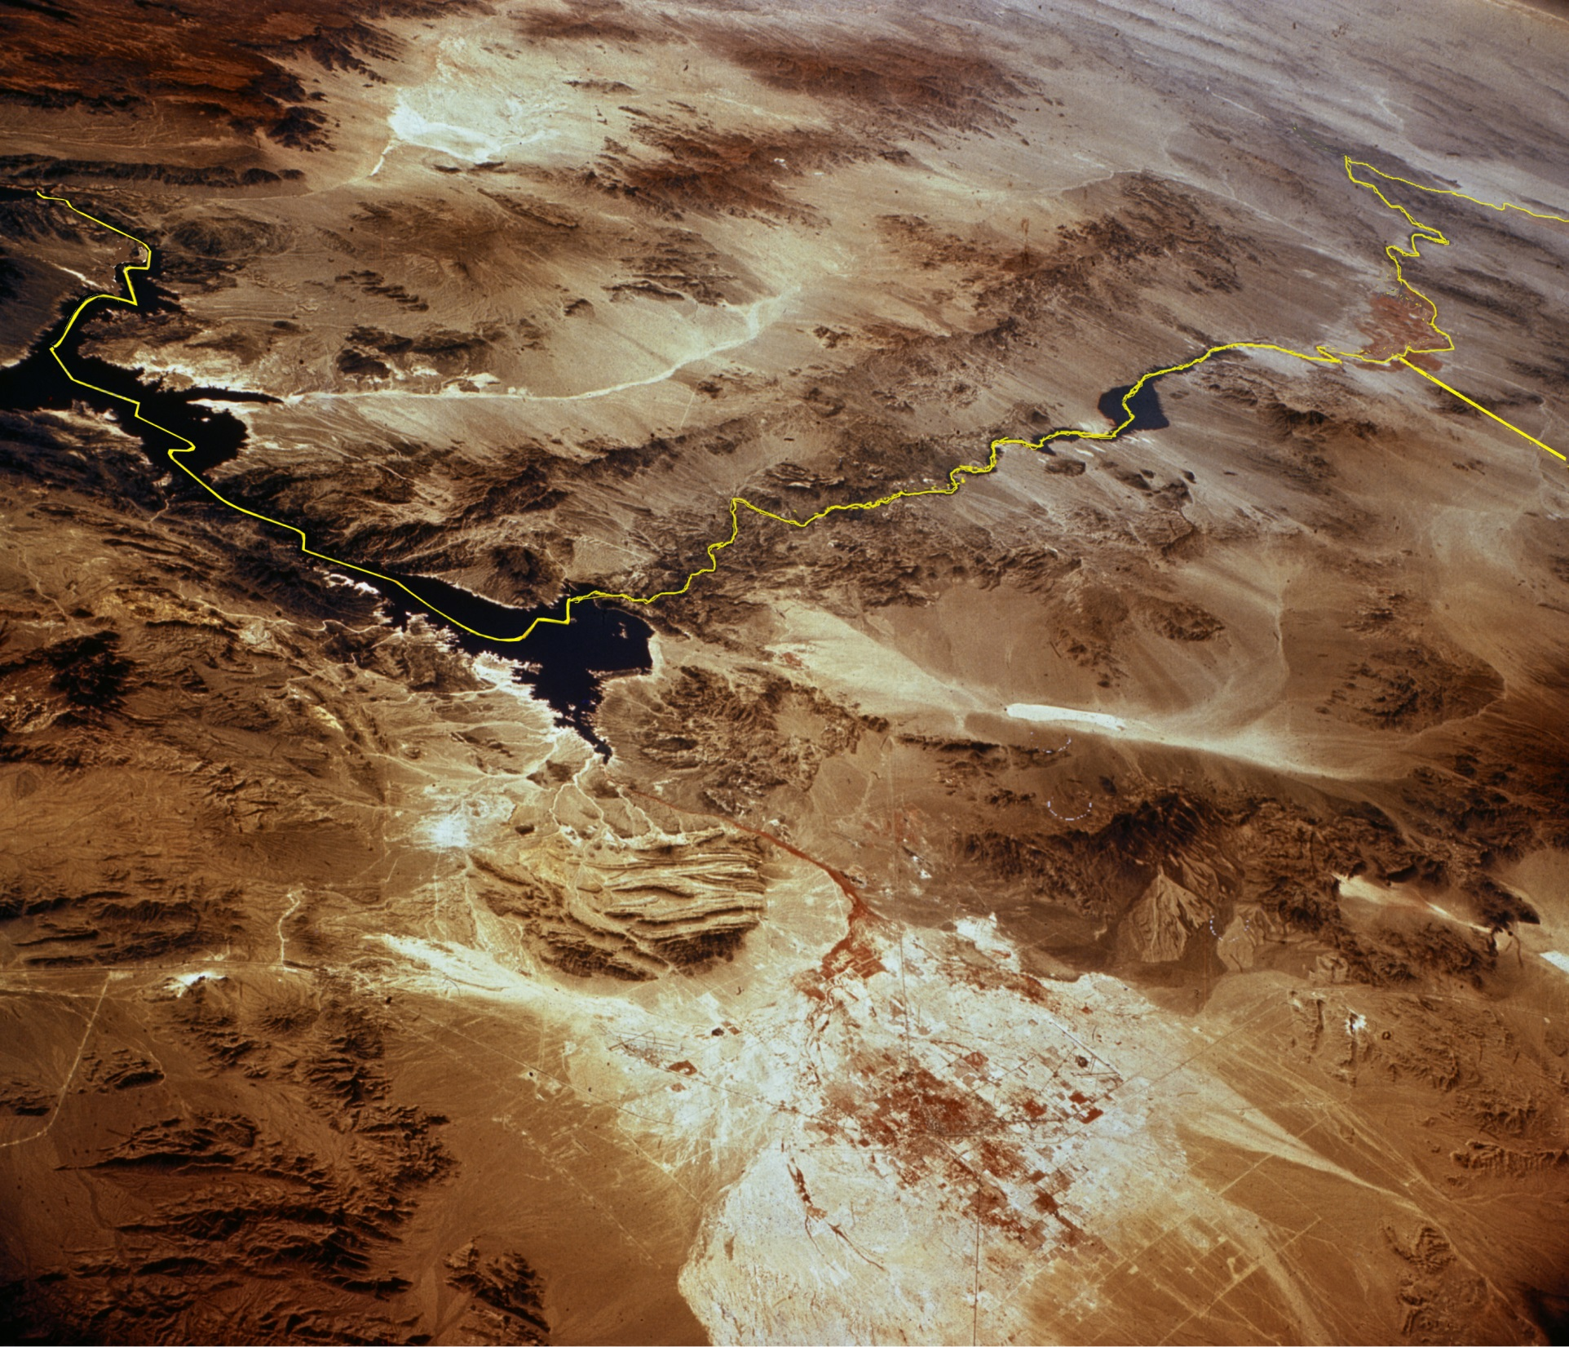
Arizona
half way
to apogee
California
Lake Mead
Nevada
Las Vegas

Slide 11
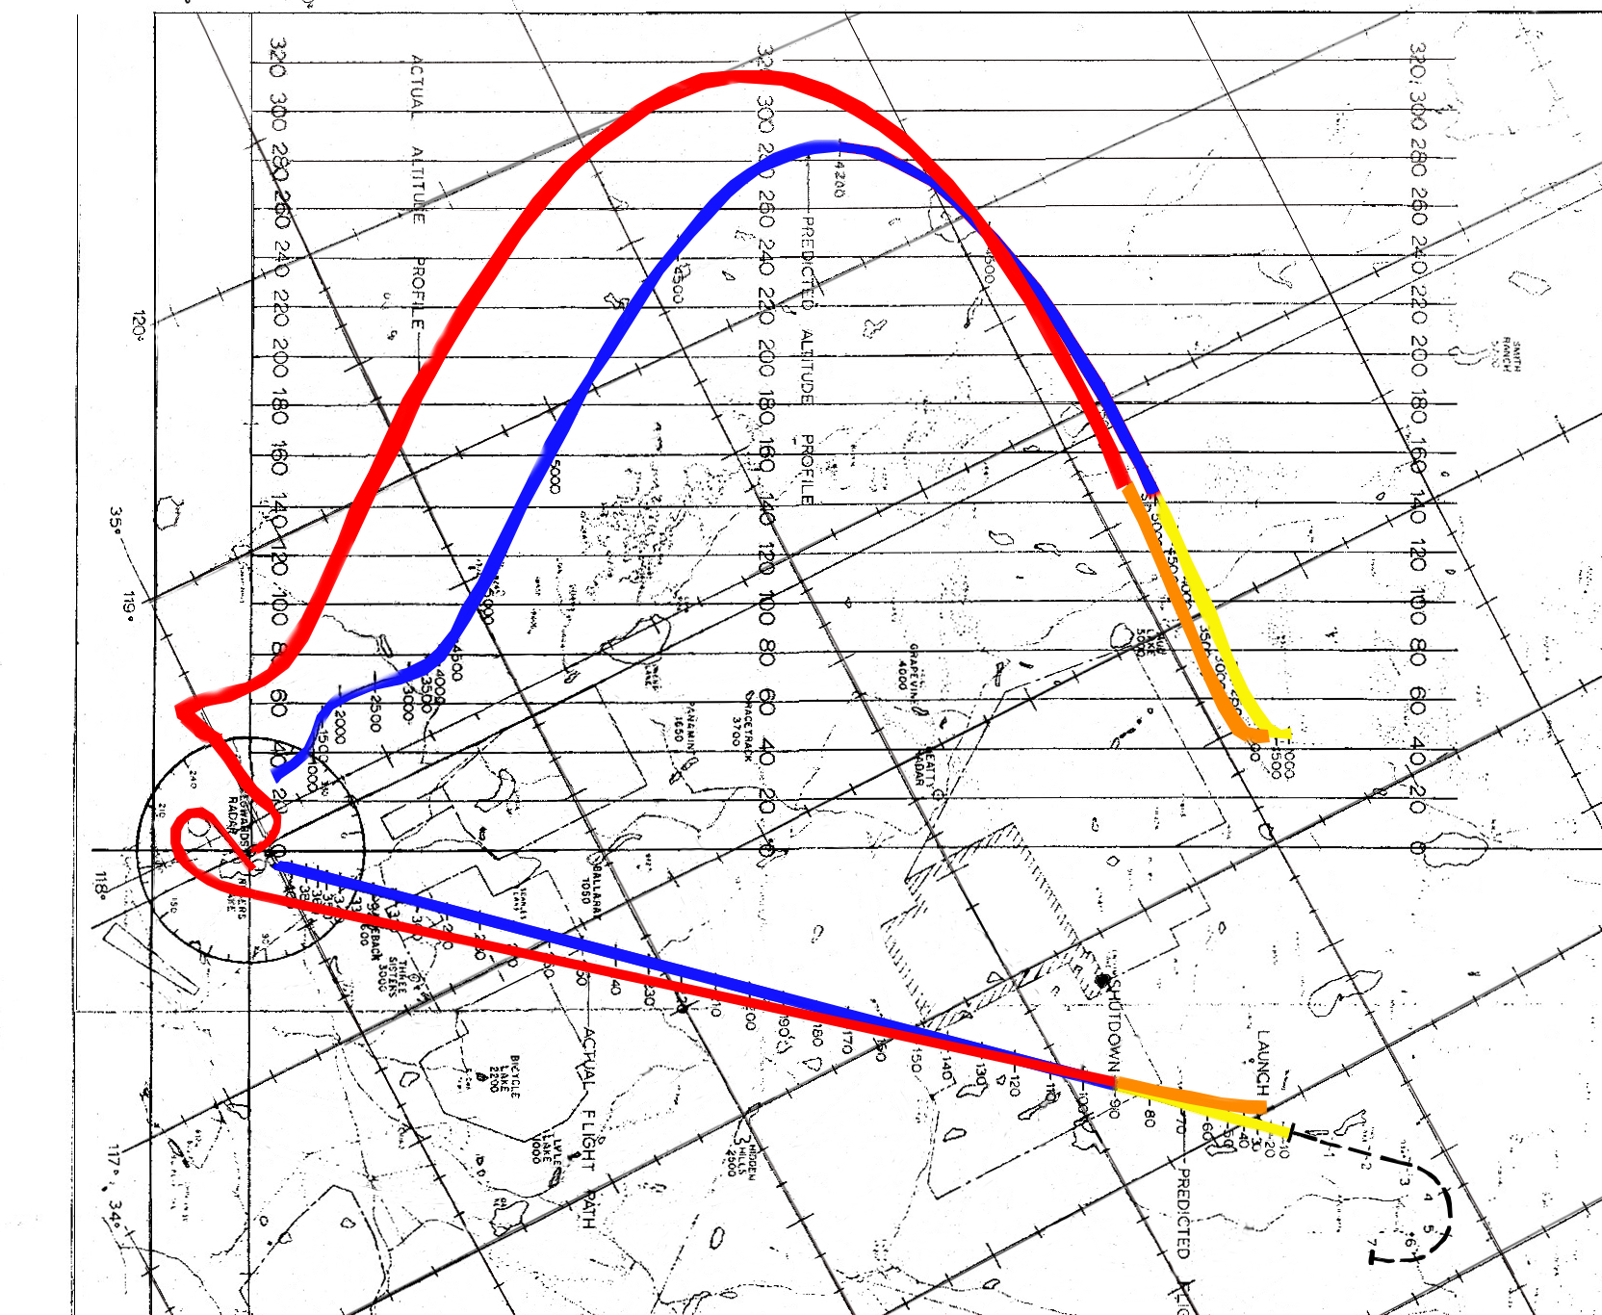

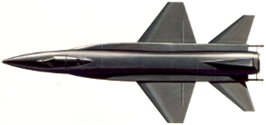
1:50
225,000 ft

Slide 12
2:00
244,000 ft

Slide 13
2:10
260,000 ft

Slide 14
2:20
275,000 ft

Slide 15
2:30
287,000 ft

Slide 16
2:40
297,000 ft

Slide 17
2:50
304,500

Slide 18
3:00
310,000 ft

Slide 19
3:10
313,500 ft

Slide 20
3:20
314,750 ft
Apogee

Slide 21
Pilot Robert M. White wrote…
… at my highest altitude I could turn my head through a 180º arc and wow! - the earth is really round.
… there was that dramatic view of earth's curvation, but there was a band of light around the earth before fading into the darkness of space. The band of light was, of course, the diffusion of sun light through our atmosphere.

Slide 22
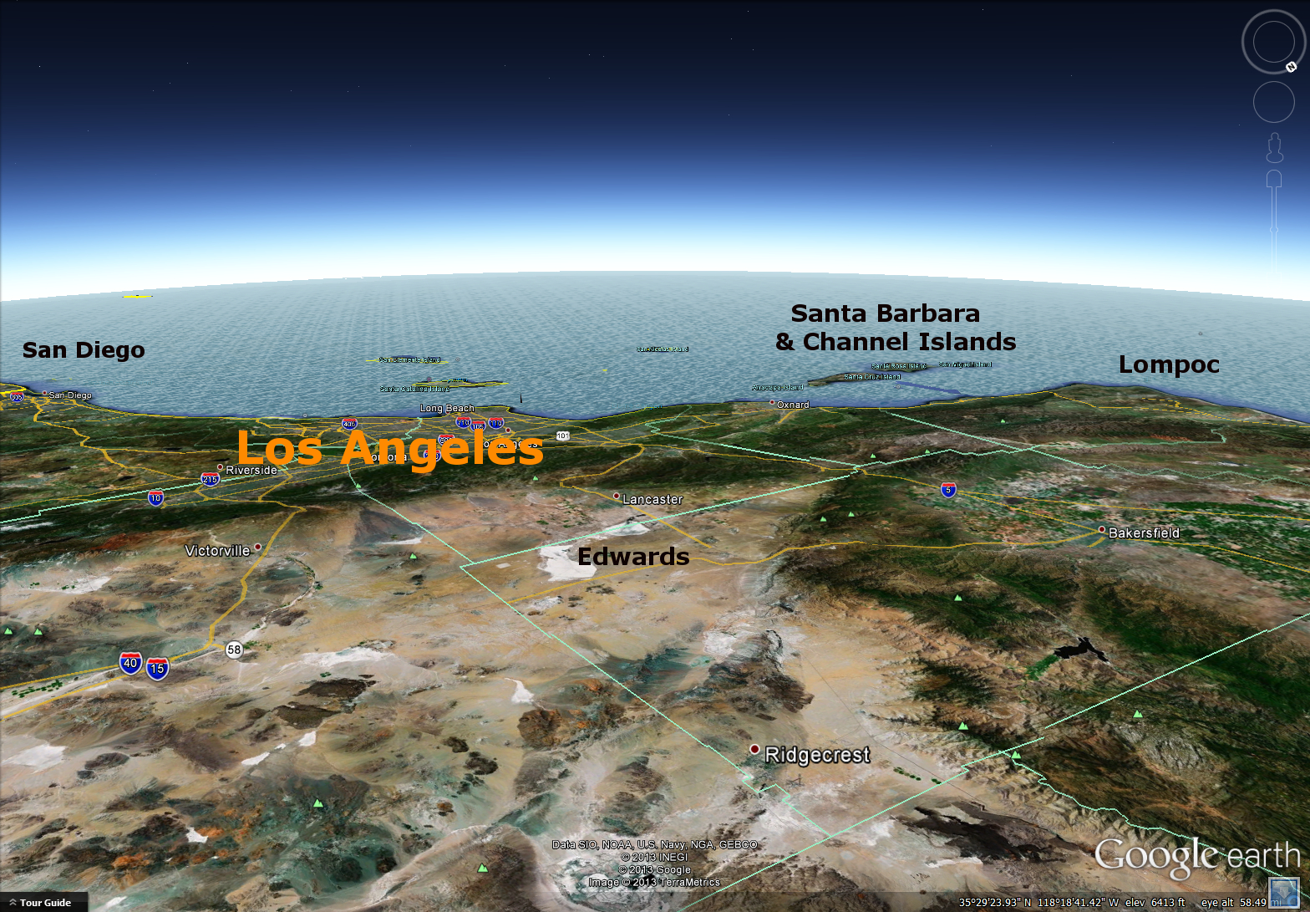

Slide 23
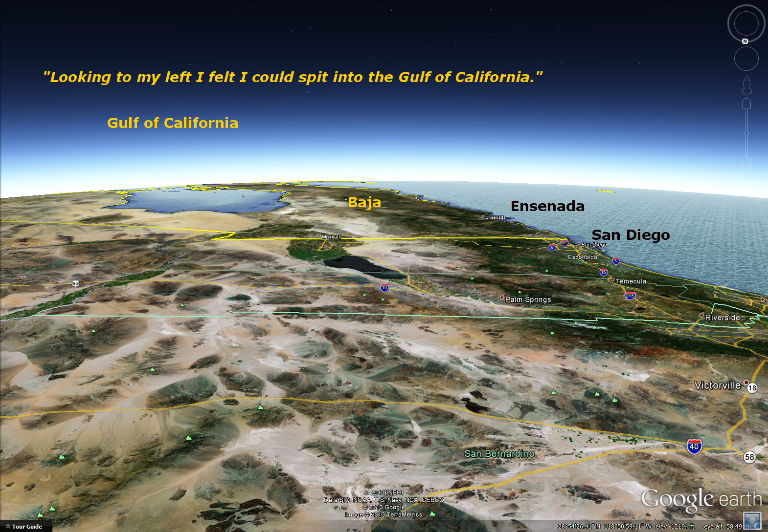

Slide 24
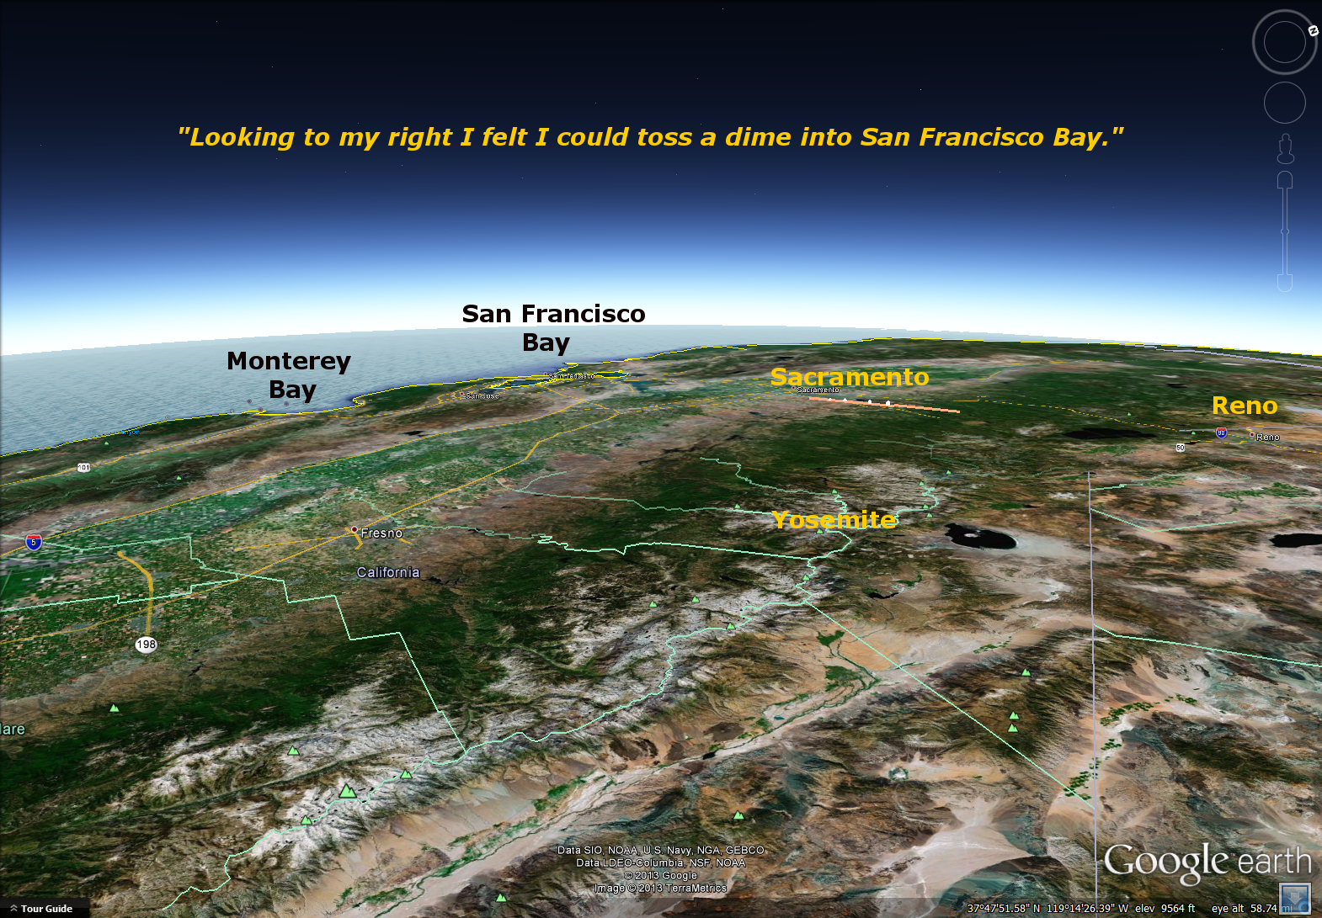

Slide 25
Higher energy than planned
will produce VERY high, VERY fast
arrival overshooting Edwards
4:40
245,600 ft
3,335 mph

Slide 26
Higher energy than planned
will produce VERY high, VERY fast
arrival overshooting Edwards
4:50
227,000 ft
3,450 mph

Slide 27
5:00
206,500 ft
3,575 mph

Slide 28
5:10
183,500 ft
3,705 mph

Slide 29
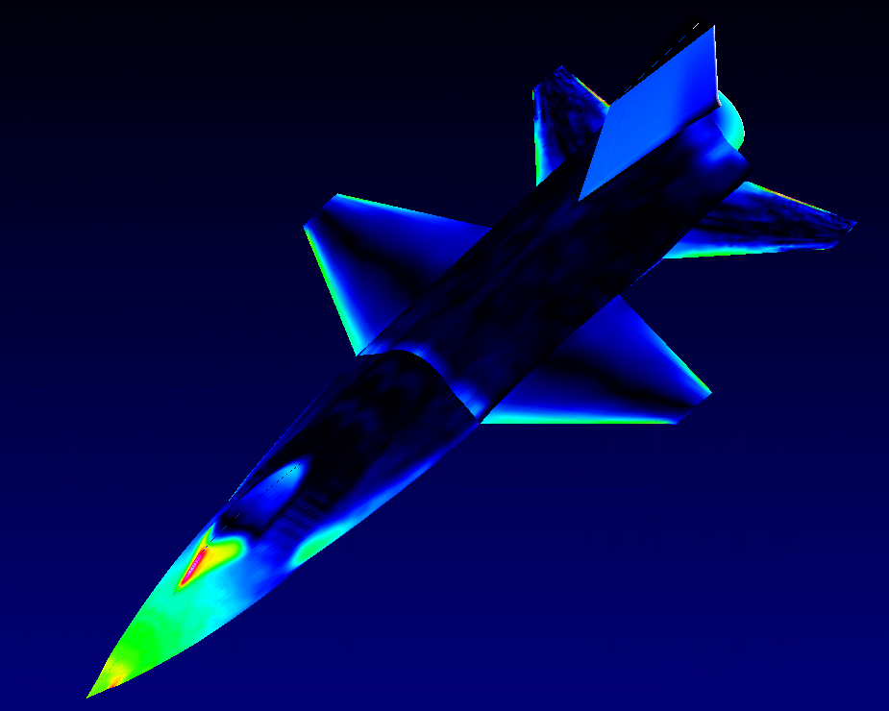
Starting soon: Reentry
Pressure quickly rises VERY high
on parts of the airframe

Slide 30
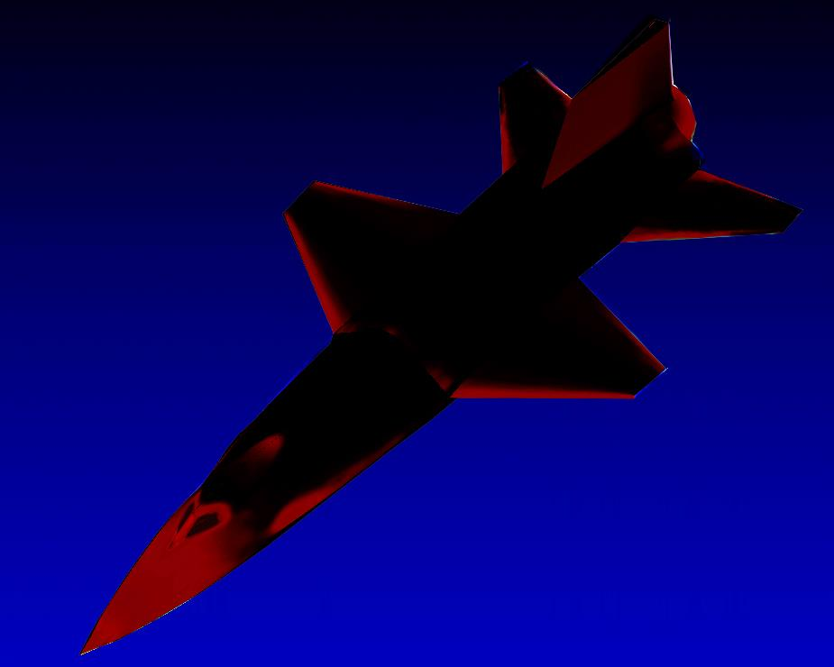
… Those parts heat to 1,200º F
and glow dull red

Slide 31
5:20
158,500 ft
3,832 mph
Top speed for this flight, Mach 5.45
Starting Reentry

Slide 32
5:30
123,000 ft
3,675 mph
Beginning pullup in reentry,
Pullup G force 1G

Slide 33
5:40
93,000 ft
3,400 mph
Reentry pullup at 5.0G
Aerodynamic slowing ~ 3G
Total load ~ 6G

Slide 34
5:50
73,000 ft
2,850 mph

Slide 35
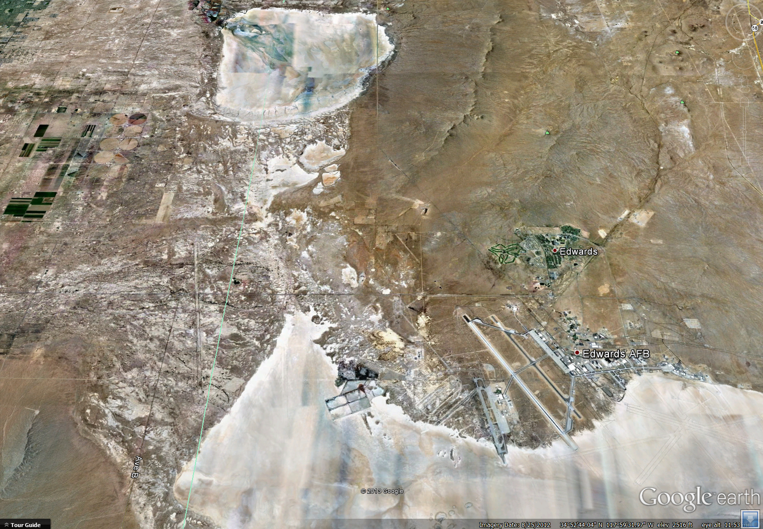
5:50
73,000 ft
2,850 mph
X-15 right-side view of Edwards, starting high-G windup turn

Slide 36
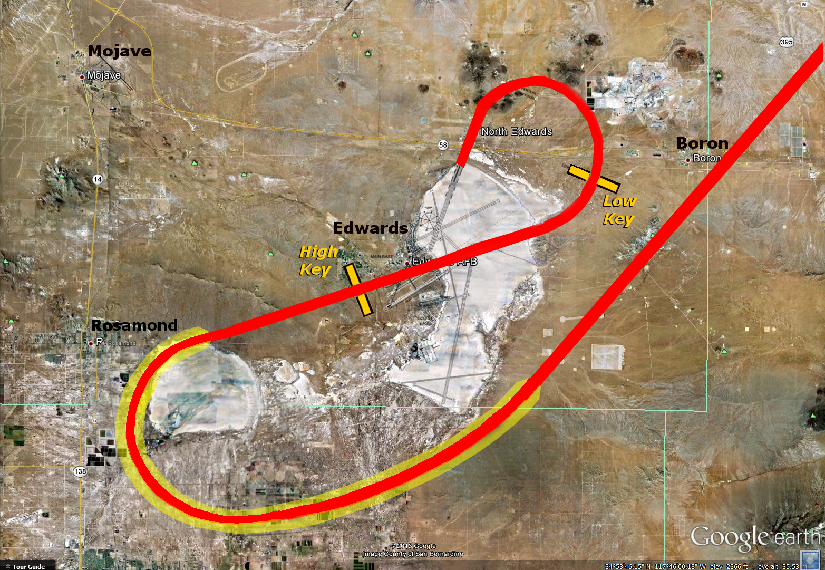
6:00
63,000 ft
2,242 mph
High
Key
High-G windup turn
maximizes slowing
while turning back

Slide 37
Mach 3
6:10
60,000 ft
1,770 mph
End of Reentry
High
Key

Slide 38
6:20
58,500 ft
1,700 mph
High
Key

Slide 39
Mach 2
6:30
56,550 ft
1,424 mph
High
Key

Slide 40
6:40
53,660 ft
1,150 mph
High
Key

Slide 41
6:50
50,350 ft
895 mph
High
Key

Slide 42
7:00
47,000 ft
690 mph
High
Key

Slide 43
Mach 1
7:10
43,300 ft
503 mph
High
Key

Slide 44
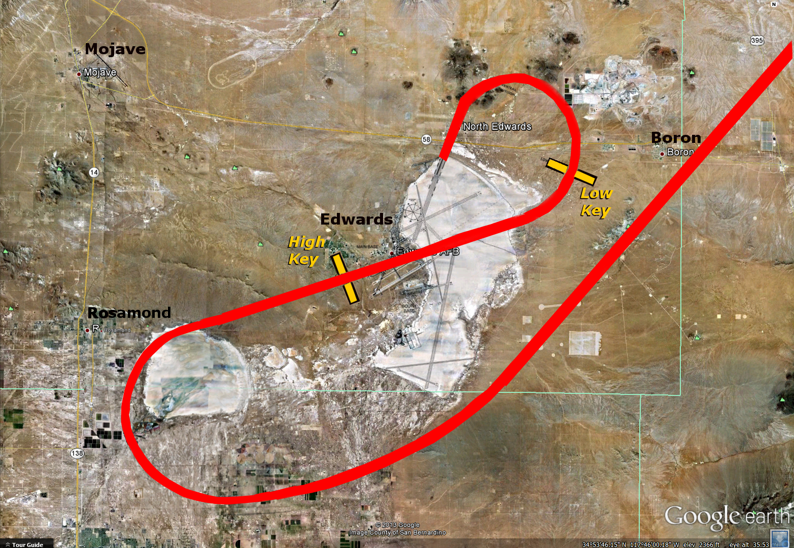
“Going to jettison” … Chase 4 (F-104B) joining up
7:20
39,725 ft
418 mph
High
Key

Slide 45
7:30
36,420 ft
367 mph
High
Key

Slide 46
7:40
33,400 ft
350 mph
High
Key

Slide 47
High Key for landing
7:50
30,500 ft
345 mph
High
Key

Slide 48
8:00
27,770 ft
345 mph
High
Key

Slide 49
8:10
25,250 ft
345 mph
High
Key

Slide 50
8:20
22,725 ft
345 mph

Slide 51
8:30
20,200 ft
345 mph

Slide 52
8:40
17,675 ft
345 mph
High
Key

Slide 53
8:50
15,150 ft
345 mph
High
Key

Slide 54
9:00
12,625 ft
345 mph
High
Key

Slide 55
9:10
10,100 ft
345 mph
High
Key

Slide 56
9:20
7,580 ft
345 mph
High
Key

Slide 57
9:30
5,050 ft
345 mph
High
Key

Slide 58
Starting landing flare, 1.5 G pullup
9:40
3,375 ft
327 mph
High
Key

Slide 59
30 seconds to touchdown
9:50
2,770 ft
295 mph
High
Key

Slide 60
10:00
2,400 ft
260 mph
High
Key

Slide 61

10 seconds to touchdown
10:10
2,250 ft
230 mph
High
Key

Slide 62
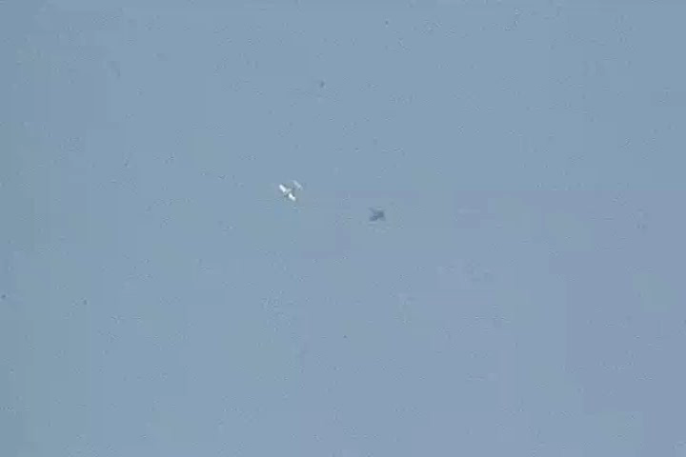

Slide 63
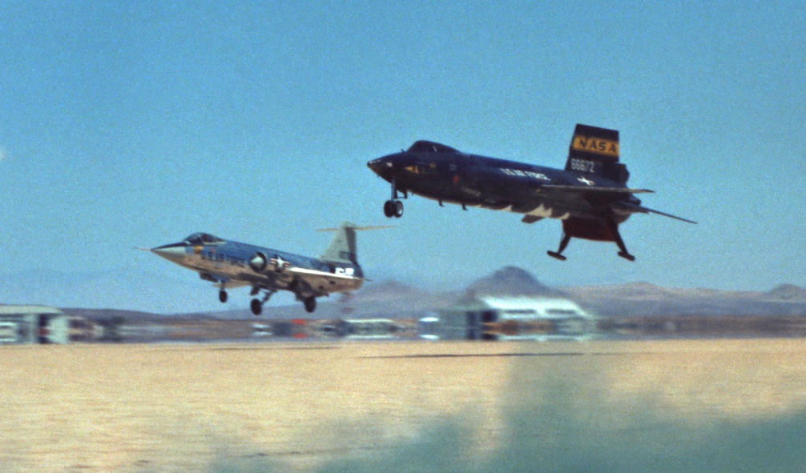
Encore…
A second video clip of landing…

Slide 64
